Slide 1
Traffic Monitoring System using Computer Vision and Machine Learning
Authors: Elaijah Edekebon,
Presented by:
Student Details:
Elaijah Edekebon
2300704665, 2023/HD05/04665U, edekebon.elaijah@students.mak.ac.ug,
Affiliation:
Makerere University
Uganda
Youtube link
https://youtu.be/2-B28uaSZEY

Slide 2
Presentation Outline
Introduction
Problem Statement
Research Objectives
Research Contributions
Methodology
Model Training and Evaluation
Results and Discussions
Conclusions
References

Slide 3
Introduction
Traditional traffic monitoring is manual, error-prone, and lacks real-time data.
Develop a tool using video analysis and machine learning for automated traffic monitoring.
Benefits:
Real-time data for dynamic traffic management.
Reduced errors compared to manual methods.
Improved traffic control and decision-making.

Slide 4
Problem Statement
Manual traffic monitoring is labor-intensive and error-prone.
Traditional methods cannot provide real-time data.
We need a more accurate, efficient, and real-time traffic monitoring solution.

Slide 5
Research Objectives
Develop a system that utilizes video object detection and classification techniques to automatically identify and categorize features in traffic videos.
Employ various machine learning models to analyze traffic conditions.
Compare the performance of different machine learning models to determine the most effective approach.

Slide 6
Research Contributions
The major contributions of the project were as follows:
Implemented the following Machine Learning models:
Support Vector Machine (SVM), Random Forest, k-Nearest Neighbors (k-NN), and Logistic Regression
Built an Essembled models that combines Random Forest, k-NN, and Logistic Regression.

Slide 7




Methodology
Data Pre-processing
Model Building
Model Evaluation
Data Collection

Slide 8
Traffic Video Preprocessing and Data Preparation
Extracting video information (frame rate, size, etc.)
Frame capture for image dataset creation
Object annotation using bounding boxes and labels
Feature extraction with color histograms
Data splitting for training and testing

Slide 9
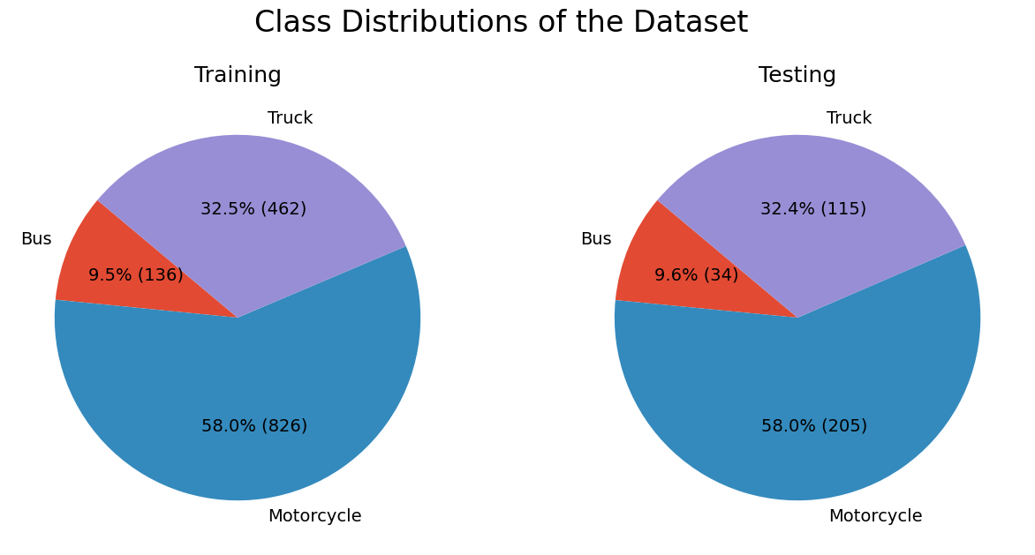
Traffic Video Preprocessing and Data Preparation cont..
Data splitting for training and testing

Slide 10
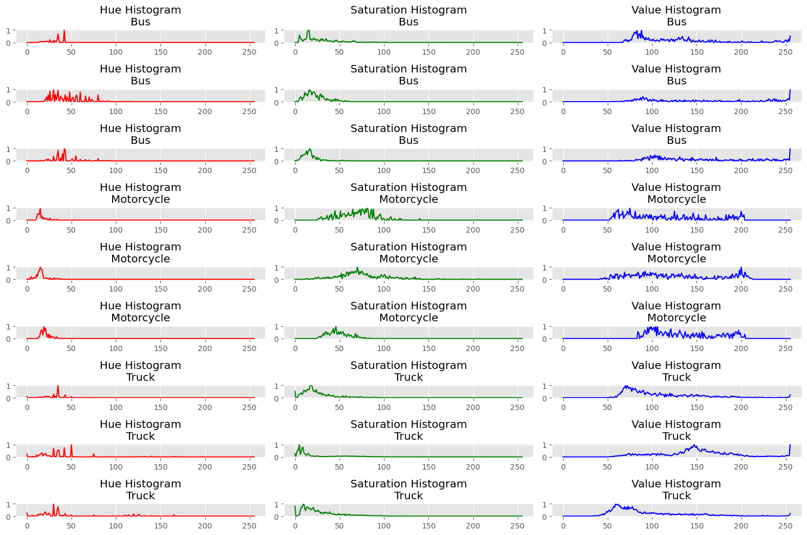
Traffic Video Preprocessing and Data Preparation cont..
Feature extraction with color histograms

Slide 11
Machine Learning Model Training and Evaluation
Model selection: Support Vector Machine (SVM), Random Forest, k-Nearest Neighbors (k-NN), Logistic Regression, and an Essembled model
Model training using the prepared training dataset
Model evaluation using the testing dataset
Performance metrics: Accuracy, F1-Score, Precision, Recall, and confusion matrix
Comparison of model performance to identify the most effective approach

Slide 12
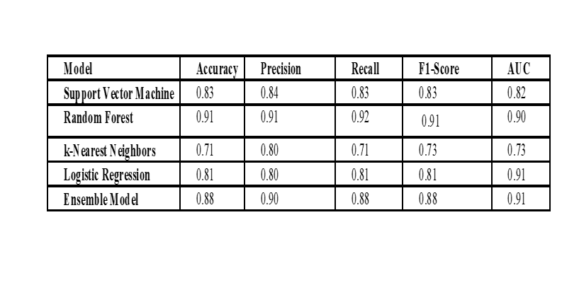
Results and Discussions

Slide 13
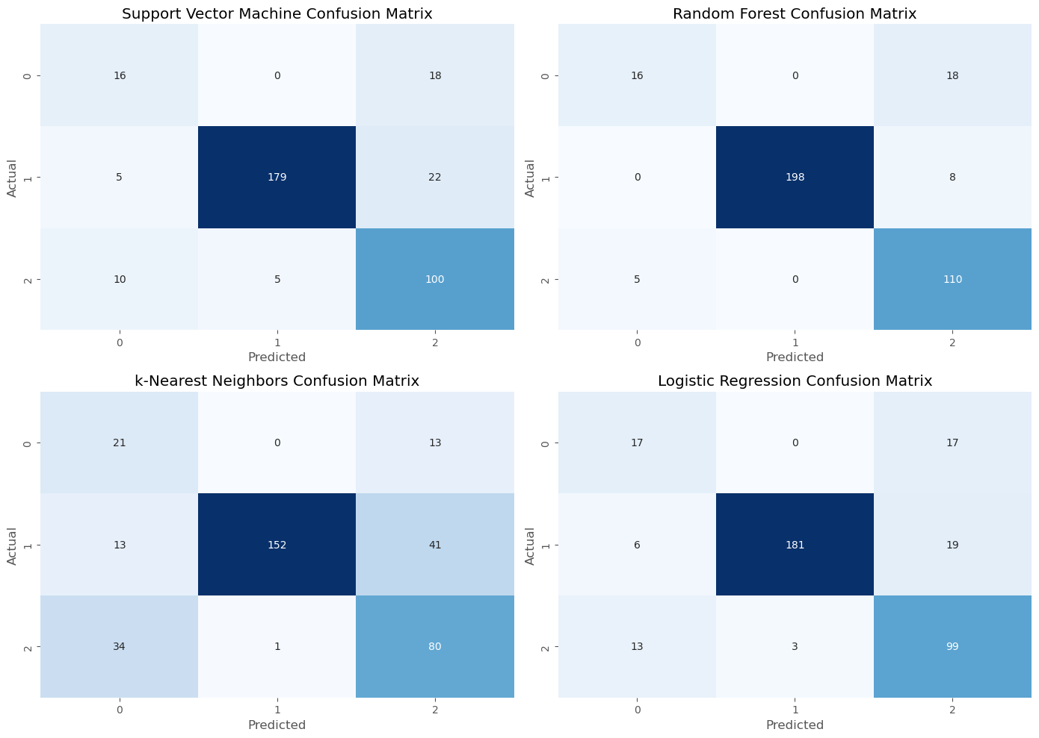
Results and Discussions – Cont’d

Slide 14
Conclusions
Traditional traffic monitoring methods are labor-intensive and error-prone.
This project explores using computer vision and machine learning for automatic traffic monitoring.

Slide 15
Thank you
Github link
Traffic-Monitoring-System-using-Computer-Vision-and-Machine-Learning/Traffic Monitoring System using Computer Vision and Machine Learning.ipynb at 4fb7b737144dd90629ac5f73ceae55dbf18f612b · elijahedekebon/Traffic-Monitoring-System-using-Computer-Vision-and-Machine-Learning · GitHub

